Slide 1


UNIT-2
Embedded Hardware Design
Presented By:
P.Vyasa Omkar, Asst.Prof.ECE
Lecture Details:
Topic:Introduction To Embedded System
IES/CSM, VII Semester.

Slide 2
Contents
Characteristics of Embedded System
Quality attributes of Embedded System
Application –specific domain –specific examples of Embedded System
Analog & Digital electronic components
I/O types and examples
Serial communication devices
Parallel ports

Slide 3
Characteristics of Embedded System
An embedded system is a specialized computing system
designed for a dedicated function.
Single Functioned – Performs one specific task.
Tightly Constrained – Limited memory, processing speed, size, and cost.
Real-Time Operation – Responds to inputs within strict time limits.
Reliability & Stability – Must work continuously without failure.
Low Power Consumption – Designed for energy efficiency.
Cost-Effective – Optimized for large-scale production at low cost.
Hardware–Software Co-Design – Tight integration for best performance.

Slide 4
Quality attributes of Embedded System
1. Functionality
System performs the intended task correctly.
Example: A pacemaker must regulate heartbeats accurately.
2. Reliability
Operates consistently without failure over time.
Example: Automotive ABS (Anti-lock Braking System)
must work in every braking situation.
3. Performance
Meets speed, throughput, and real-time requirements.
Example: Airbag deployment within milliseconds.

Slide 5
Quality attributes of Embedded System
4. Efficiency (Power & Resource Usage)
Optimized for low power, memory, and processing.
Example: Battery-powered IoT sensors.
5. Maintainability
Easy to update, test, and repair.
Example: Firmware upgrades in smart devices.
6. Safety & Security
Protects users and data from hazards or attacks.
Example: Medical devices with secure data transmission.

Slide 6
Examples by Domain
1. Automotive Systems
Anti-lock Braking System (ABS)
Engine Control Unit (ECU)
Airbag Control System
2. Consumer Electronics
Smart TVs
Washing Machines
Microwave Ovens
3. Industrial Automation
CNC Machines
Programmable Logic Controllers (PLC)Robotic Arms
4. Medical Devices
Pacemakers
Blood Glucose Monitors
ECG Machines
5. Communication & Networking
Routers
Modems
Network Switches
6. Defense & Aerospace
Missile Guidance Systems
Radar Systems
Flight Control Systems

Slide 7
specific examples of Embedded System
Embedded systems are specialized computer systems designed for specific tasks within larger devices.
Examples include digital watches, washing machines, microwave ovens, and even components within vehicles like engine control units.
These systems are often "hidden" within the device, performing their designated function without requiring significant user interaction.

Slide 8
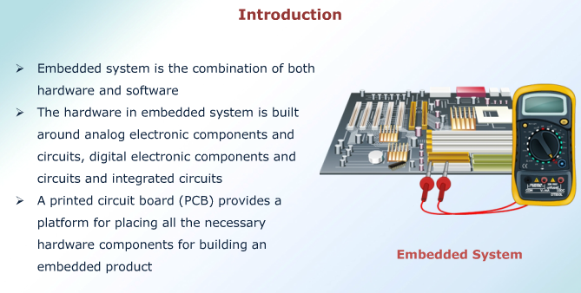
Analog Electronic Components

Slide 9
Analog Electronic Components
Electrolytic capacitors, ceramic capacitors, tantalum capacitors, etc. are the commonly used capacitors in embedded hardware design.
Inductors are widely used for filtering the power supply from ripples and noise signals.
Inductors with inductance value in the microhenry (µH) range are commonly used in embedded applications for filter and matching circuit implementation.

Slide 10
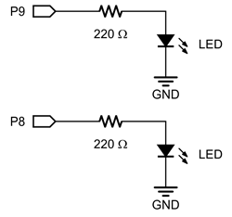
Analog Electronic Components
Resistors, capacitors, diodes, inductors, operational amplifiers(OpAmps), transistors, etc. are the commonly used analog electronic components in embedded hardware design.
A resistor limits the current flowing through a circuit. Interfacing of LEDs, buzzer, etc. with the port pins of microcontroller through current limiting resistors is a typical example for the usage of resistors in embedded application.

Slide 11
Analog Electronic Components
P-N Junction diode, Schottky diode, Zener diode, etc. are the commonly used diodes in embedded hardware circuits.
A schottky diode is same as a P-N junction diode except that its forward voltage drop (voltage drop across diode when conducting) is very low (of the order of 0.15V to 0.45) when compared to ordinary P-N junction diode (of the order of 0.7V to 1.7V).

Slide 12
Analog Electronic Components
Also the current switching time of schottky diode is very small compared to the ordinary P-N junction diode.
A zener diode acts as normal P-N junction diode when forward biased.
It also permits current flow in the reverse direction, if the voltage is greater than the junction breakdown voltage. It is normally used for voltage clamping applications.

Slide 13
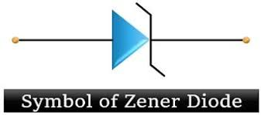
Analog Electronic Components
Reverse polarity protection, voltage rectification(AC-DC converters), freewheeling of current produced in inductive circuits, clamping of voltages to a desired level (e.g., Brown-out protection circuit implementation using zener diode), etc. are examples for the usage of diodes in embedded applications.

Slide 14
Analog Electronic Components
Transistors in embedded applications are used for either switching or amplification purpose.
In switching application, the transistor is in either ON or OFF state.
In amplification operation, the transistor is always in the ON state (partially ON).

Slide 15
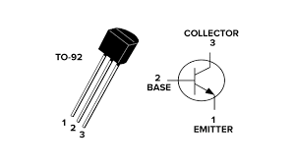
Analog Electronic Components
The common emitter configuration of NPN transistor is widely used in switching and driving circuits in embedded applications.
Relay, buzzer and stepper motor driving circuits are examples for common emitter configuration based driver circuit implementation using transistor.

Slide 16
Digital Electronic Components
Digital electronics deal with digital or discrete signals.
Microprocessors, microcontrollers and System on chips (SoCs) work on digital principles. They interact with the rest of the world through digital I/O interfaces and process digital data.
Embedded systems employ various digital electronic circuits for ‘Glue logic’ implementation.

Slide 17
Digital Electronic Components
‘Glue logic’ is the custom digital electronic circuitry required to achieve compatible interface between two different integrated circuit chips.
Address decoders, latches, encoders/decoders, etc.are examples for glue logic circuits.
Transistor Transistor Logic (TTL), Complementary Metal Oxide Semiconductor (CMOS) logic etc are some of the standards describing the electrical characteristics of digital signals in a digital system.

Slide 18
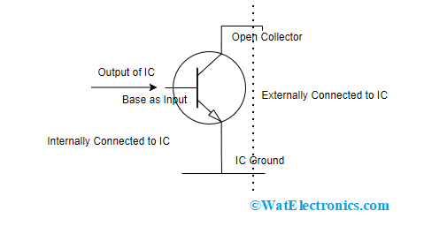
Digital Electronic Components
Open collector and Tri-state output:-
Open collector is an I/O interface standard in digital system design and a common type of output found on many Integrated Circuit(IC) chip which behaves like a switch that is either connected to ground or disconnected.

Slide 19
Digital Electronic Components
Instead of outputting a signal of a specific voltage or current, the output signal is applied to the base of an internal NPN transistor whose collector is externalised(open) on a pin of the IC.
The emitter of the transistor is connected internally to the ground pin.
For the output pin to function properly, the output pin should be pulled, to the desired voltage for the output device, through a pull up resistor.

Slide 20
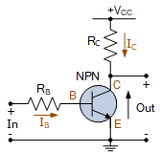
Digital Electronic Components
The o/p signal of the IC is fed to the base of an open collector transistor.
When the base drive to the transistor is ON and the collector is in open state, the o/p pin floats.

Slide 21
Digital Electronic Components
This state is also known as ‘high impedance’ state. Here the o/p is neither driven to logic ‘high’ nor logic ‘low’.
If a pull-up resistor is connected to the o/p pin, when the base drive is ‘ON’, the o/p pin becomes at logic 0(0v).
With a pull-up resistor, if the base driver is 0, the o/p will be at logic high(Voltage=Vcc).

Slide 22
Digital Electronic Components
The advantages of open collector output in embedded system are listed below.
i) It facilitates the interfacing of devices, operating at a voltage different from the IC, with the IC. Thereby, it eliminates the need for additional circuits for connecting devices at different voltages levels.

Slide 23
Digital Electronic Components
ii) An open collector configuration supports multi-drop connection, i.e., connecting more than one open collector output to a single line. It is a common requirement in modem embedded systems supporting communication interfaces like I2C, 1-Wire, etc.
Iii) It is easy to build ‘Wired AND’ and ‘Wired OR’ configuration using open collector output lines.

Slide 24
Digital Electronic Components
Tri-state output:-
The output of a standard logic device has two states, namely “Logic o (LOW)” and “Logic 1(HIGH)” whereas tri-state devices have three states for the output, namely, “Logic o (LOW)” and “Logic 1(HIGH)” and the “High Impedance(FLOAT)”.
A tri-state logic device contains a device activation line called ”Device Enable”.

Slide 25
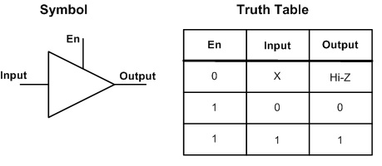
Digital Electronic Components
When the “Device Enable” line is activated(set at ”Logic 1” for an active “High” enable input and at ”Logic 0” for an active “Low” enable input), the device acts like a normal logic device and the o/p will be in any one of the logic conditions, “Logic 0 (LOW)” or “Logic 1 (HIGH)”.

Slide 26
Digital Electronic Components
Logic Gates:-
The Logic gates are the building blocks of digital circuits.
Logic gates control the flow of digital information by performing a logical operation of the input signals.
Depending on the logical operation, the logic gates used in digital design are classified into-AND, OR, XOR, NOT, NAND, NOR and XNOR.
The logical relationship between the output signal and the input signals for a logic gate is represented using a truth table.

Slide 27
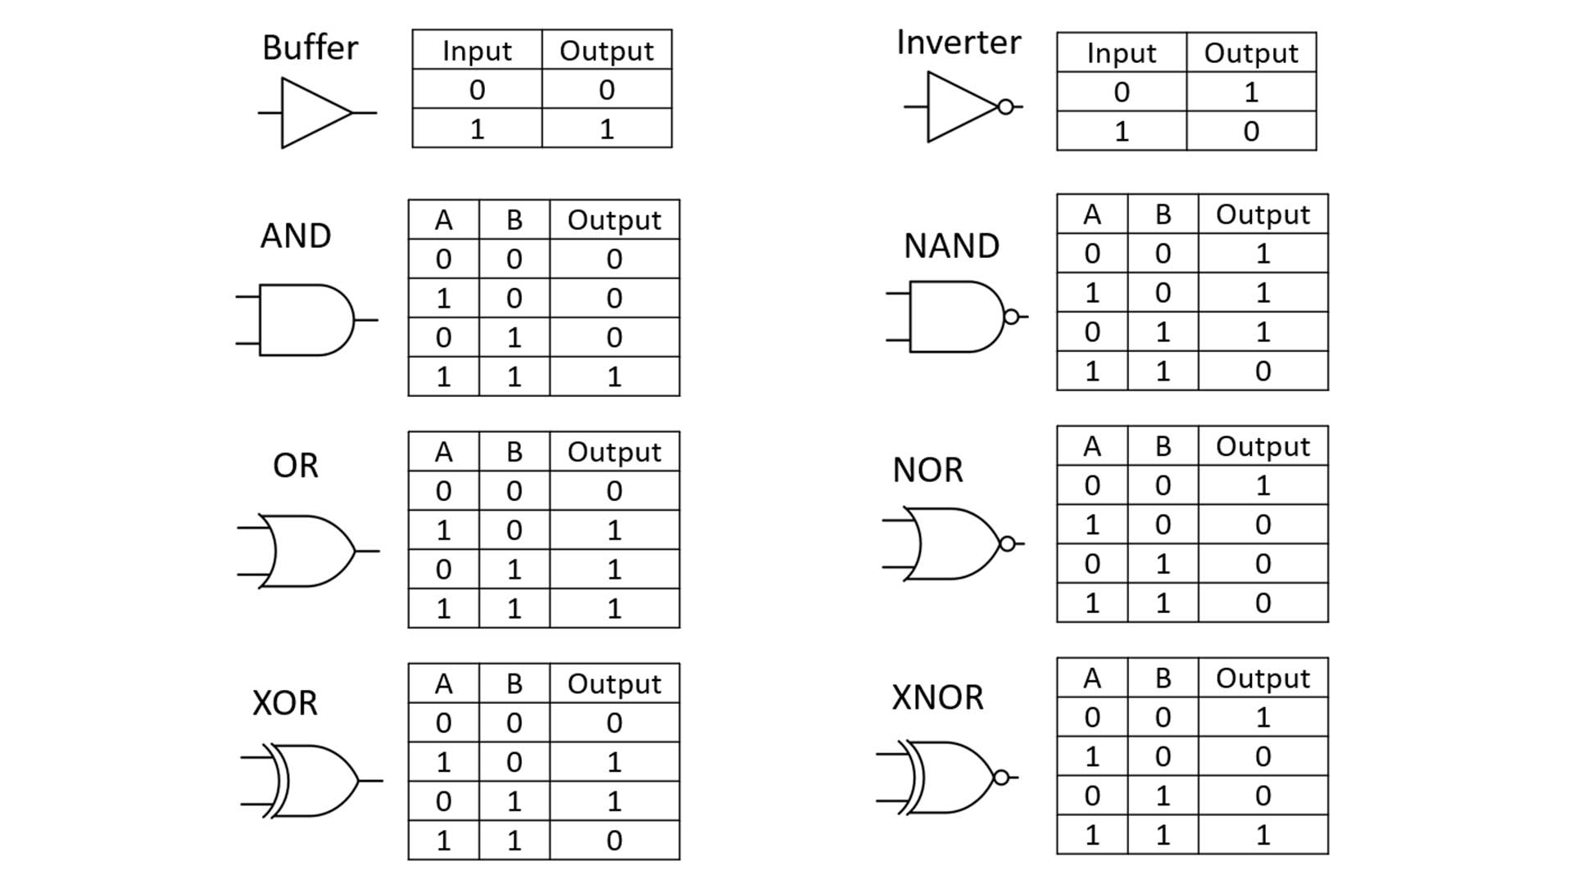
Digital Electronic Components

Slide 28
Digital Electronic Components
Buffer:-
A buffer circuit is a logic circuit for amplifying the current or power.
It increases the driving capability of a logic circuit.
A tri-state buffer is a buffer with Output Enable control.
When the Output Enable control is active (Low for Active low enable and High for Active high enable), the tri-state buffer functions as a buffer.

Slide 29
Digital Electronic Components
Buffer:-
If the Output Enable is not active, the output of the buffer remains at high impedance state (Tri-stated).
Tri-state buffers are commonly used as drivers for address bus and to select the required device among multiple devices connected to a shared data bus.
Tri-state buffers are available as either unidirectional or bi-directional buffers.

Slide 30
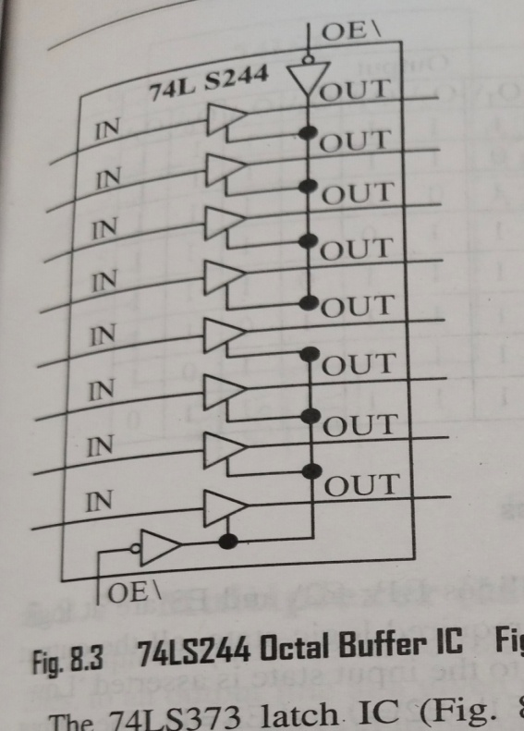
Digital Electronic Components
Buffer:-
74LS244/74HC244 is an example of unidirectional octal buffer.
It contains 8 individual buffers which are grouped into two.
Each buffer group has its own output enable line.
Figure illustrates the 74LS244 buffer device.

Slide 31
Digital Electronic Components
74LS245 is an example of bi-directional tri-state buffer.
It allows data flow in both directions, one at a time.
The data flow direction can be set by the direction control line.
One buffer is allocated for the data line associated with each direction.

Slide 32
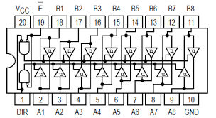
74LS245
The 74LS245 is an 8-bit bus transceiver IC used to transfer data between two buses in both directions.
It is commonly used in microprocessor systems to connect the CPU, memory, and peripherals.
Data can flow from A → B or B → A depending on the DIR (Direction) pin.
OE̅ =(Output Enable) pin enables or disables the outputs.
OE̅ = HIGH, outputs are in high impedance (tri-state) mode
(effectively disconnected from the bus).

Slide 33
Key Features & Applications
Key Features:
Bi-directional: Can transfer data in both directions.
Tri-state outputs: Allows multiple devices to share the same bus without interference.
TTL Logic: Works with standard TTL voltage levels (typically 5V).
Applications: Bus interfacing, memory sharing, microcontroller communication, and bidirectional data transfer.

Slide 34
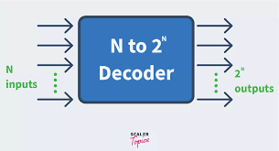
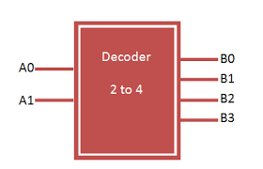
Digital Electronic Components
Decoder:-
A decoder is a logic circuit which generates all the possible combinations of the input signals.
Decoders are named with their input line numbers and the possible combinations of the input as output.

Slide 35
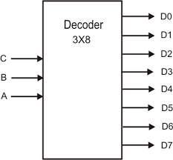
Digital Electronic Components
Decoder:-
Examples are 2 to 4 decoder, 3 to 8 decoder and 4 to 16 decoder.
The 3 to 8 decoder contains 3 input signal lines and it is possible to have 8 different configurations with the 3 lines (000 to 111 in the input line corresponds to 0 to 7 in the output line).

Slide 36
Digital Electronic Components
Decoder:-
Depending on the input signal, the corresponding o/p line is asserted. For example, for the i/p state 001, the o/p line 2 is asserted.
Decoders are mainly used for address decoding and chip select signal generation in electronic circuits and are available as integrated circuits.

Slide 37
Digital Electronic Components
74LS138/74AHC138 is an example for 3 to 8 decoder IC. Figure illustrates the 74AHC138 decoder and the table function for it.
The decoder o/p is enabled only when the “Output Enable” signal lines E1\, E2\ and E3 are at logic levels 0,0 and 1 respectively.
If the output-enable are signals at the required logic state, all the output lines are forced to the inactive (High) state.

Slide 38
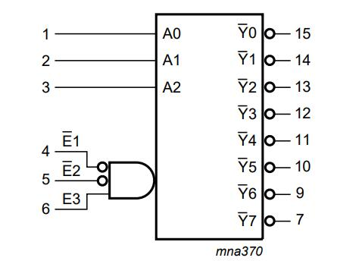
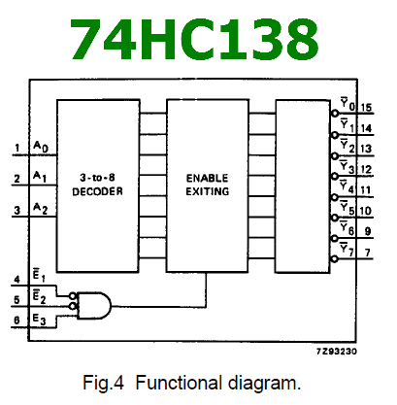
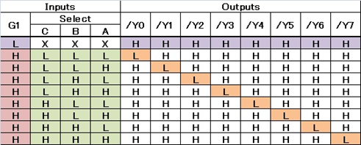
Digital Electronic Components

Slide 39
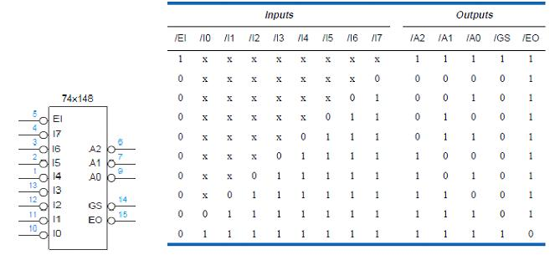
Digital Electronic Components
Encoder:-

Slide 40
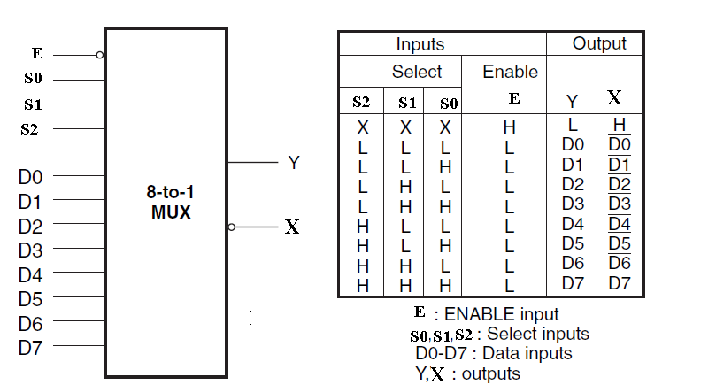
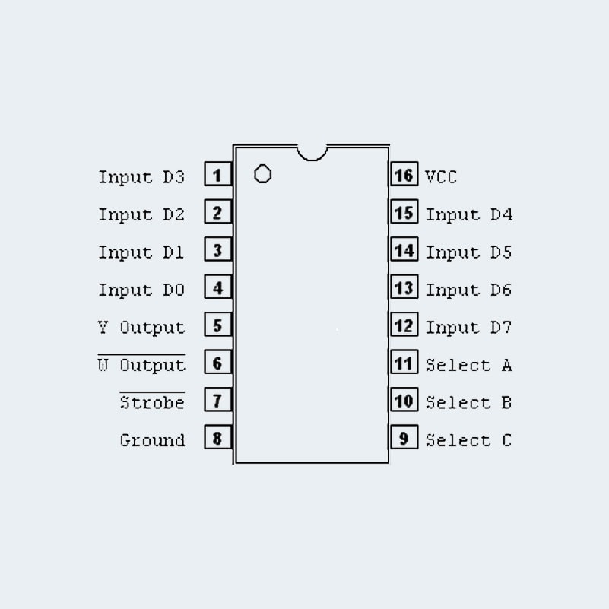
Digital Electronic Components
Multiplexer:-

Slide 41
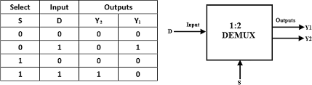
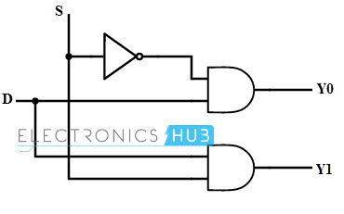
Digital Electronic Components
De-Multiplexer:-

Slide 42
Digital Electronic Components
Combinational Circuits:-
In digital system design, a combinational circuit is a combination of the logic gates.
The output of the combinational circuit, at a given point of time, is dependent only on the state of the inputs at the given point of time.
The combinational circuit do not use any memory.

Slide 43
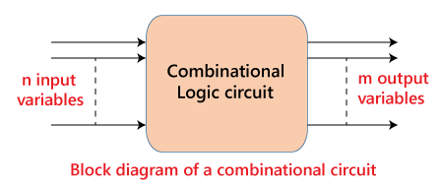
Digital Electronic Components
Combinational Circuits:-
Encoders, decoders, multiplexers, de-multiplexers, adder circuits, comparators, multiple input gates, etc. are examples of digital combinational circuits.
A combinational circuit can have an n number of inputs and m number of outputs.

Slide 44
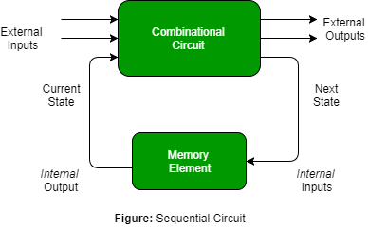
Digital Electronic Components
Sequential Circuits:-
In Digital logic circuit, whose output at any given point of time depends on both the present and past inputs, is known as sequential circuits.
Hence, sequential circuits contain a memory element for holding the previous input states.

Slide 45
Digital Electronic Components
Sequential Circuits:-
Flip-flops act as the basic building blocks of sequential circuits. Sequential circuits are of two types, namely-synchronous (clocked) sequential circuits and asynchronous sequential circuits.
The operation of a synchronous sequential circuit is synchronised to a clock signal, whereas an asynchronous sequential circuit does not require a clock for operation.
For an asynchronous sequential circuit, the response depends upon the sequence in which the input signal changes.

Slide 46
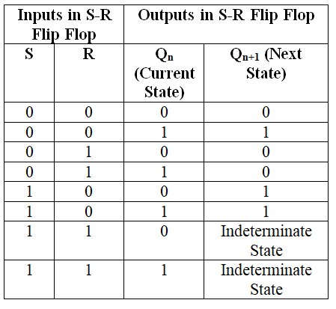
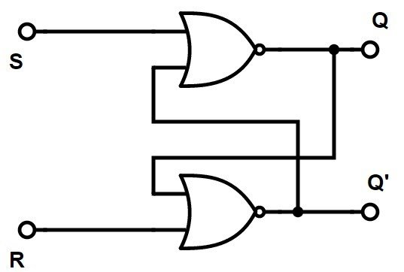
Digital Electronic Components
S-R Flipflop:-

Slide 47
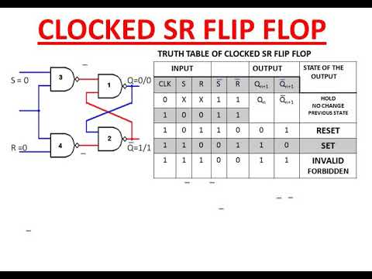
Digital Electronic Components
S-R Flipflop:-

Slide 48
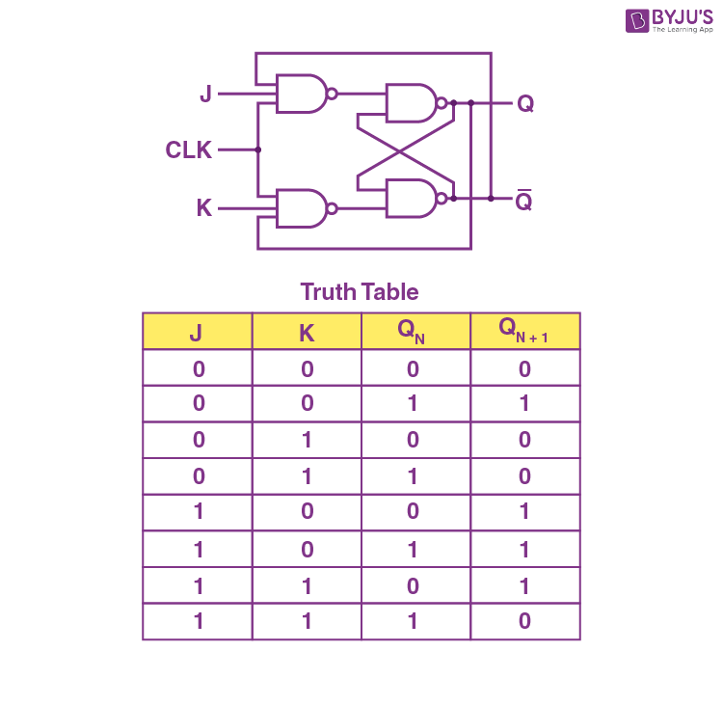
Digital Electronic Components
JK Flipflop:-

Slide 49
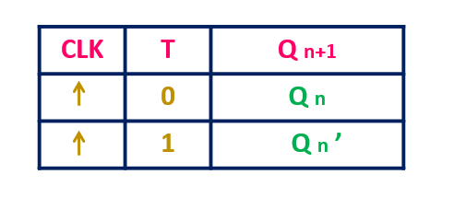
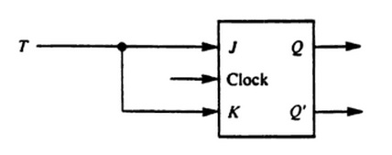
Digital Electronic Components
T Flipflop:-

Slide 50
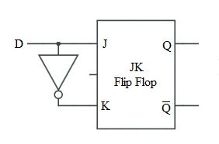
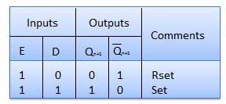
Digital Electronic Components
D Flipflop:- A D Flip-Flop (Data or Delay Flip-Flop) is a digital storage device that stores one bit of data. It has:
One data input (D)
One clock input (CLK)
One output (Q) and its complement (Q‾)
Working:
On the rising or falling edge of the clock (depending on design), the value at the D input is transferred to the Q output.
Output remains constant until the next active clock edge.

Slide 51
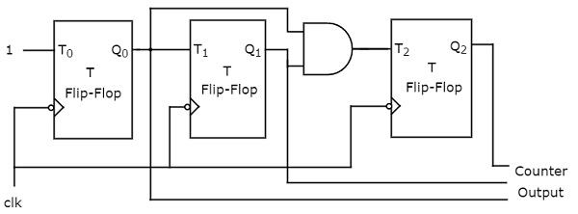
Digital Electronic Components
Binary counter using T Flipflops:-
A binary counter is a sequential circuit that counts in binary form. Using T Flip-Flops is one of the simplest ways to design it.
Binary Counter Working
Connect multiple T Flip-Flops in series.
The output of one flip-flop acts as the clock input for the next.
First Flip-Flop (LSB) toggles on every clock pulse.
Each next flip-flop toggles when the previous one changes from 1 → 0.
This creates a binary count sequence (000, 001, 010, 011, …).

Slide 52
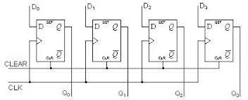
Digital Electronic Components
4 bit register using D Flipflops:-

Slide 53
I/O Types & Examples
A port is a device that connects the processor to external peripherals (devices, processors, or controllers).
It can receive bytes from an external device and store them so the processor can read them later.
It can send bytes from the processor to an external device.
A port is connected to the processor through an address decoder and system buses.

Slide 54
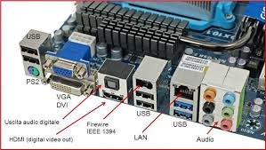
I/O Types & Examples
The processor uses port register addresses to:
Set the port’s functions or modes
Read the port’s status
Write or read bytes of data
A serial port is used for serial communication.
In serial communication, one bit is sent at a time over a line or channel.
The bits are sent at regular time intervals controlled by a clock.

Slide 55
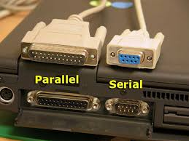
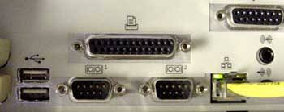
I/O Types & Examples
A parallel port is a port for parallel communication. Parallel communication means that multiple bits can communicate over a set of parallel lines at any given instance.

Slide 56
I/O Types & Examples
Types of serial ports :-
Synchronous serial input
Synchronous serial output
Asynchronous serial UART input
Asynchronous serial UART output
Both as input and as output, for example, modem.

Slide 57
I/O Types & Examples
Synchronous serial input:-
Synchronization means separation by a constant interval or phase difference.
The sender along with the serial bits, also sends the clock pulses SCLK (serial clock) to the receiver port pin.
The port synchronizes the serial data- input bits with clock bits. Each bit as well as each bit in each byte in synchronization.

Slide 58
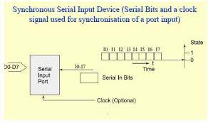
I/O Types & Examples
Synchronous serial input:-

Slide 59
I/O Types & Examples
Synchronous serial input:-
MOSI (Master Out Slave In) – The master sends data to the slave in sync with the SCLK (serial clock) from the master. The slave receives data according to the master’s clock.
MISO (Master In Slave Out) – The slave sends data to the master in sync with the SCLK from the master. The slave transmits data according to the master’s clock.
Synchronous serial input is used for:
Interprocessor data transfer
Audio input
Streaming data input

Slide 60
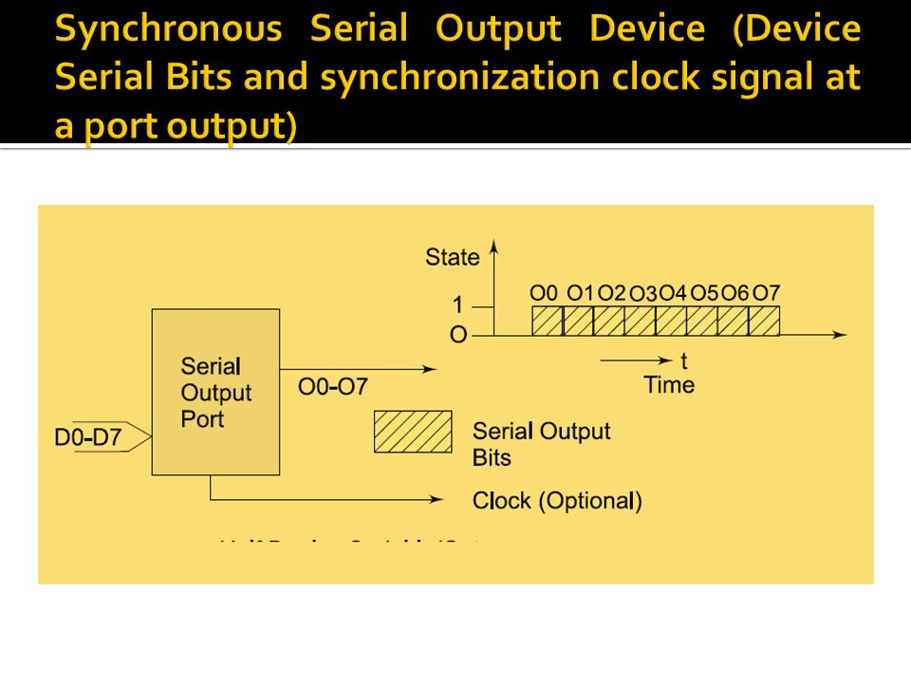
I/O Types & Examples
Synchronous serial output:-
Each bit in a byte is sent in sync with a clock signal.
The sender provides clock pulses at the SCLK pin or sends clock pulses and serial data through the same output line.
When using the same line, the clock pulses modulate or encode the serial output bits.

Slide 61
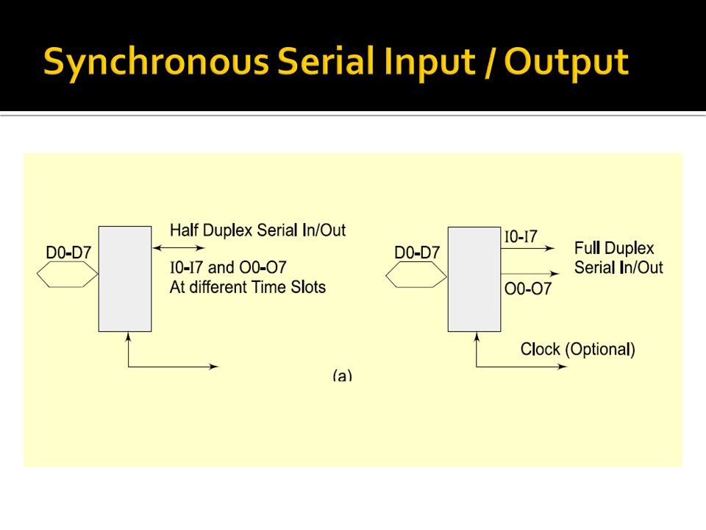
I/O Types & Examples
Synchronous serial input/output:-
Each bit in each byte synchronizes with the clock input and output.
The bytes are sent or received at constant rates.

Slide 62
I/O Types & Examples
Synchronous serial input/output:-
The I/Os can also be on same I/O line when input/output clock pulses either suitably modulate or encode the serial input/output respectively.
If clock period = T, then data transfer rate is (1/T) bps.
The processing element at the port (peripheral) sends and receives the byte at a port register to or from where the microprocessor writes or reads the byte.

Slide 63
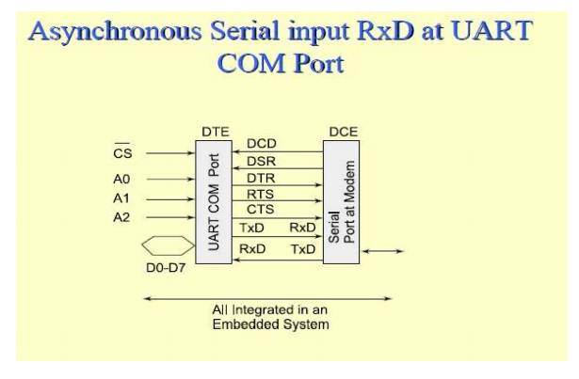
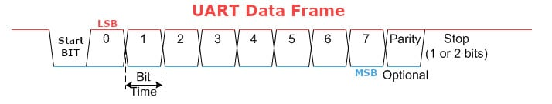
I/O Types & Examples
Asynchronous serial input:-

Slide 64
I/O Types & Examples
Asynchronous serial input:-
Does not receive the clock pulses or clock information along with the bits.
Each bit in received in each byte at fixed intervals but each received byte is not in synchronization.
Bytes separate by the variable intervals or phase differences.
Asynchronous serial input is also called UART input if serial input is according to UART protocol.

Slide 65
I/O Types & Examples
Asynchronous serial output:-
Asynchronous output serial port line TxD (transmit data).
Each bit in each byte transmit at fixed intervals but each output byte is not in synchronization(separates by a variable interval or phase difference). Minimum separation is 1 stop bit interval.

Slide 66
I/O Types & Examples
Half Duplex:-
Half duplex means as follows: at an instant communication can only be one way (input or output) on a bi-directional line.
An example of half-duplex mode telephone communication. On one telephone line, the talk can only in the half-duplex way mode.

Slide 67
I/O Types & Examples
Full Duplex:-
Full duplex means that at an instant, the communication can be both ways.
An example of the full duplex asynchronous mode of communication is the communication between the modem and the computer through TxD and RxD lines or communication using SI in modes 1, 2, and 3 in 8051.

Slide 68
I/O Types & Examples
Types of parallel ports :-
Parallel port one bit input.
Parallel port one bit output.
Parallel port multi-bit input.
Parallel port multi-bit output.

Slide 69
I/O Types & Examples
Parallel port multi-bit input:-
ADC input from liquid measuring sensor or temperature sensor or pressure sensor or speed sensor or d.c motor rpm sensor Encoder inputs for bits for angular position of a rotating shaft or a linear displacement of an object.

Slide 70
I/O Types & Examples
Parallel port multi-bit output:-
LCD controller for Multilane LCD display matrix unit in a cellular phone to display on the screen the phone number, time, messages, character outputs or pictogram bit-images for display screen or e-mail or web page.
Print controller output.
Stepper-motor coil driving bits.

Slide 71
I/O Types & Examples
Parallel port input-output:-
PPI 8255
Touch screen in mobile phone

Slide 72
Serial Communication Devices
Serial communication devices:-
Synchronous communication
When a byte (character) or a frame (a collection of bytes) in of the data is received or transmitted at the constant time intervals with uniform phase differences, the communication is called as synchronous.

Slide 73
Serial Communication Devices
Two characteristics of Synchronous communication are as follows:
1. Bytes (or frames) maintain a constant phase difference and are synchronous, i.e., in synchronization.
There is no permission to send either bytes or frames at variable time intervals – This does not facilitates for handshaking between the serial transmitter port and serial receiver port.

Slide 74
Serial Communication Devices
A clock ticking at a certain rate has always to be there for transmitting serially the bits all of the bytes (or frames) serially.
Mostly, the clock is not always implicit to the synchronous data receiver. The transmitter generally transmits the clock rate information in the synchronous communication of the data.

Slide 75
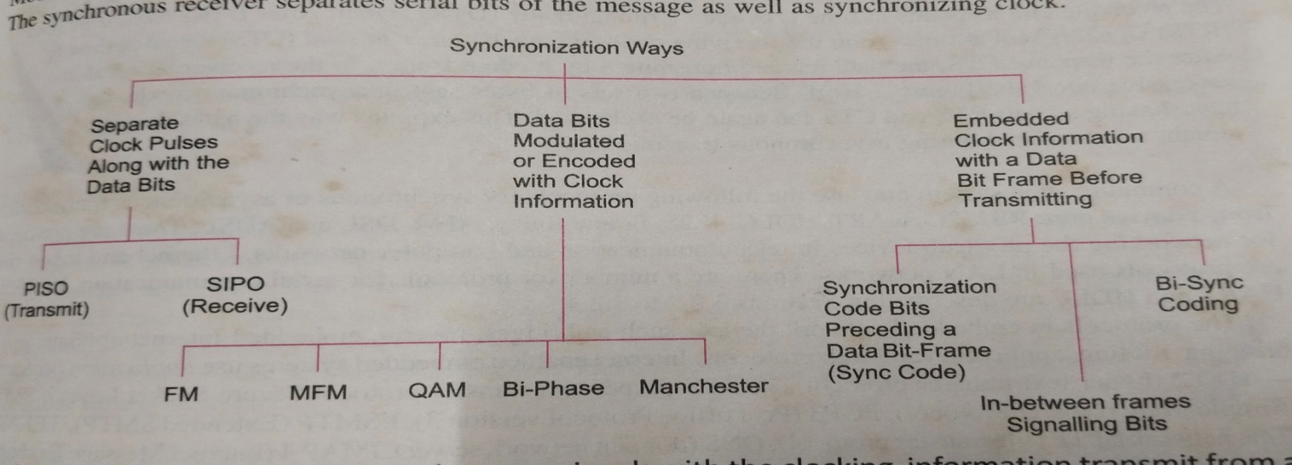
Serial Communication Devices
Ten methods by which synchronous signals with the clocking information transmit from a master device to slave device.

Slide 76
Serial Communication Devices
Asynchronous communication:-
Two characteristics of Asynchronous communication are as follows:
1. Bytes (or frames) need not maintain a constant phase difference and are asynchronous i.e., need not in synchronization.
There is permission to send either bytes or frames at variable time intervals-This facilitates for handshaking between the serial transmitter port and serial receiver port.

Slide 77
Serial Communication Devices
RS232
UART
SPI
SDIO
HDLC

Slide 78
Serial Communication Devices
SDIO:-
Secure Digital Association (SD)
SD – an association of over 700 companies started from 3 companies in 1999.
Created a new flash memory card format, called SD format for Ios.
SDIO card has become popular feature in handheld mobile devices, PDAs, digital cameras and embedded systems.

Slide 79
Serial Communication Devices
SDIO:-
SD card size – just 0.14 cm x 2.4 cm x 3.2 cm.
Allowed to stick out of the handheld device open slot, which can be at the top in order to facilitate insertion of the SD card
A processing element functions used SDIO host controller to process the Ios.
Controller may include SPI controller to support SPI mode for the Ios and also supports the needded protocol functionality internally

Slide 80
Serial Communication Devices
SDIO:-
SD card size – just SDIO(Secure Digital Input Output) card can have up to eight logical functions.
Functions include IOs with several protocols, for example , IrDA adapter, Ethernet adapter, GPS or WiFi, Bluetooth, WLAN, digital camera, barcode or RFID code readers

Slide 81
Serial Communication Devices
HDLC(High-level Data Link Control):-
HDLC is a standard protocol for the data link network.
For synchronous communication between two data link layers on a network.
There are two formats standard HDLC and Extended HDLC for 2⁸ and 2¹⁶ destination devices or systems respectively.

Slide 82
Parallel Device Ports
Short distances, generally within a circuit board or IC or nearby external devices.
Advantage- Number of 8 bits over the wires in parallel.
High data transfer rate.
Disadvantage- More number of wires.
Capacitive effect in parallel wires reduces the length up to which communication in parallel can take place.
High capacitance results in delay for the bits at the other end undergoing transition from 0 to 1 or 1 to 0.

Slide 83
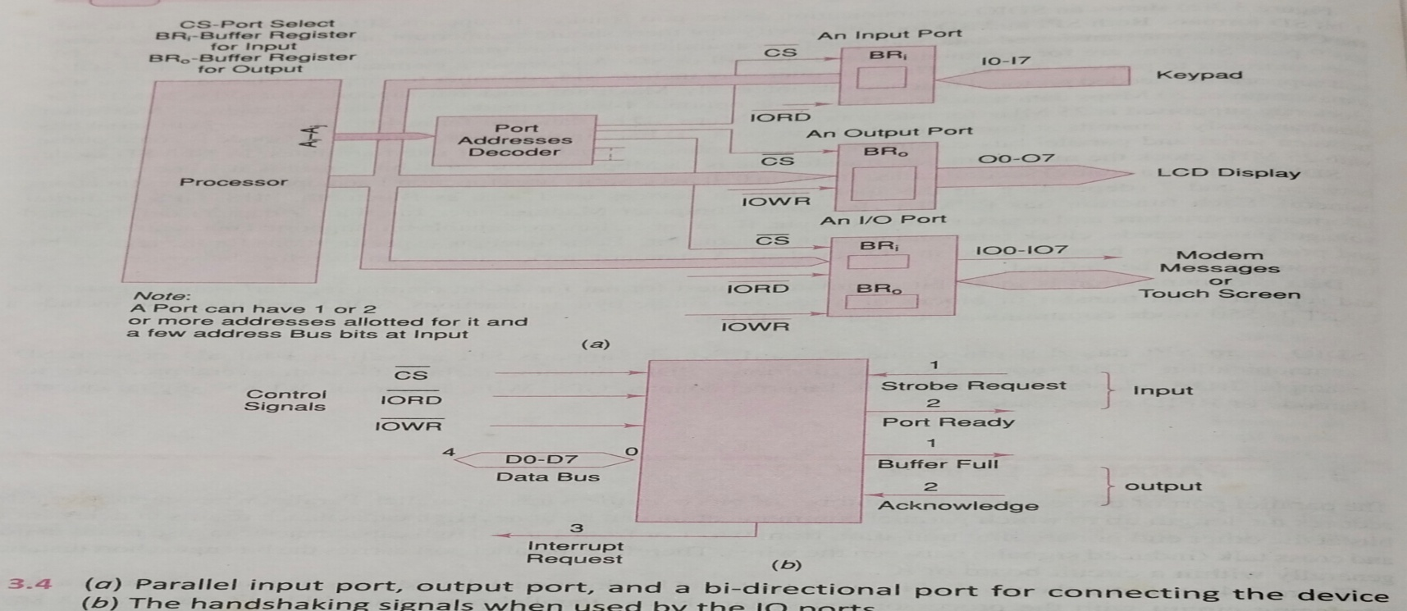
Parallel Device Ports
The below figure shows the parallel input, output and bidirectional device ports

Slide 84
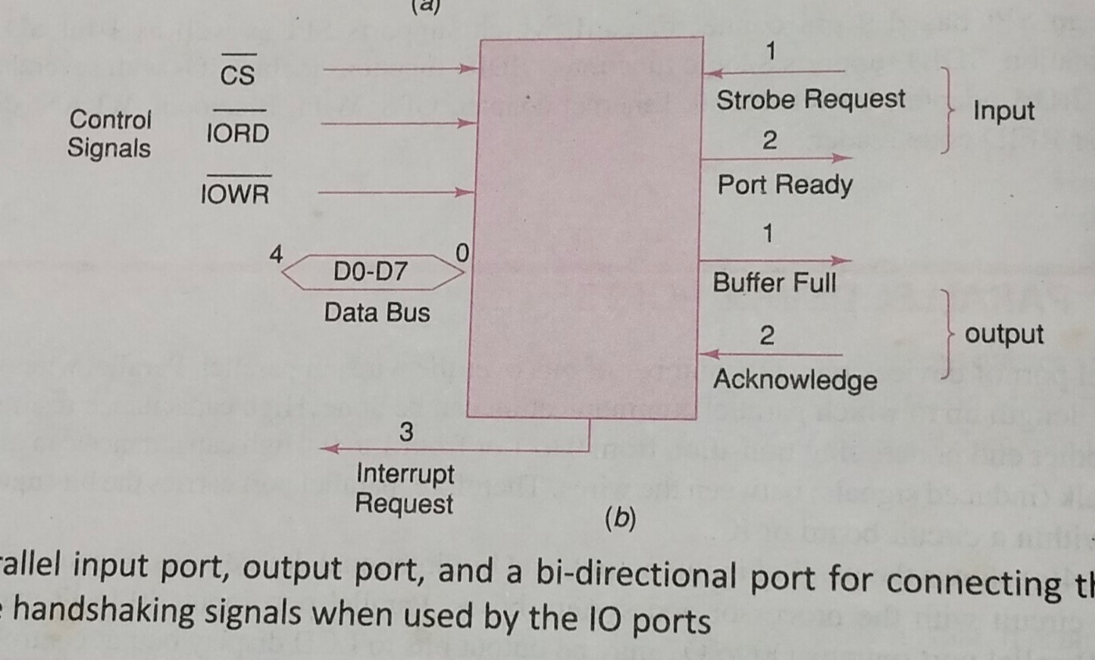
Parallel Device Ports
Device makes a strobe request to port, STROBE after it is ready to send the byte and system I/O port sends the acknowledgement, PORT READY

Slide 85
Parallel Device Ports
System I/O port receives data in buffer and then issues an interrupt signal, INT to processor to enable an ISR execution.
Device sends the message ACKNOWLEDGE when and the I/O device port ends the BUFFER FULL signal to inform that the is buffer full.
The processor is sent to the INTERRUPT REQUEST message, when the transmitting-buffer is empty (available for next write)

Slide 86
Parallel Device Ports
IO device interfacing circuit with the processor and system buses and connections to external peripherals/systems.
Parallel port inputs I0-I7 maybe from a keypad controller.
Parallel output ports O0-O7 may be output bits to LCD display output controller.
Bri and Br0 buffers maybe provided at bidirectional I/O port.

Slide 87
Parallel Device Ports
When receiving-buffer is full (available for next read).
When transmitting-buffer is empty (available for next read).

Slide 88
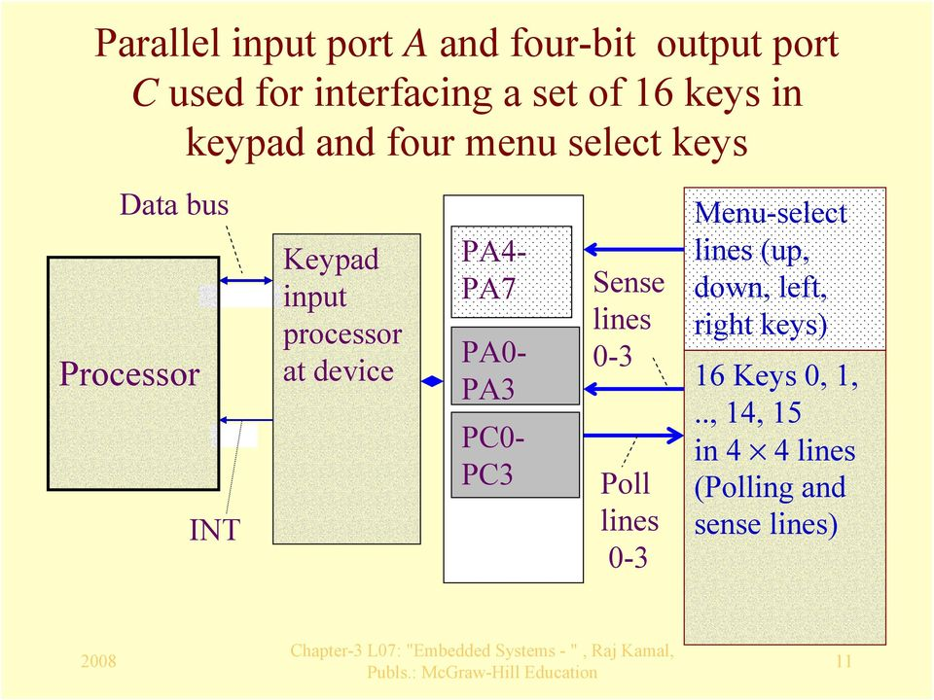
Parallel Device Ports
Parallel port interfacing with switches and keypad

Slide 89
Parallel Device Ports
Assume that state idle logic state =1.
Four bits of an 8 bit input port A (A4-A7) for four menu select keys.
16 keys – arranged in four rows and four columns.
Other four bits of A (A0-A3)- input from four common ends of four rows.
Four bits of output port C (C0-C3)- output to four common ends of four columns.

Slide 90
Parallel Device Ports
Processing element computes the code of the pressed key and generates a signal when a key is found pressed.
From the bit pattern found at A0-A3, the processing element computes the 7 bit ASCII code of the pressed key at that instance and send output for the code through D0-D6.
It also outputs D7=1 if a key is found pressed else D7=0.

Slide 91
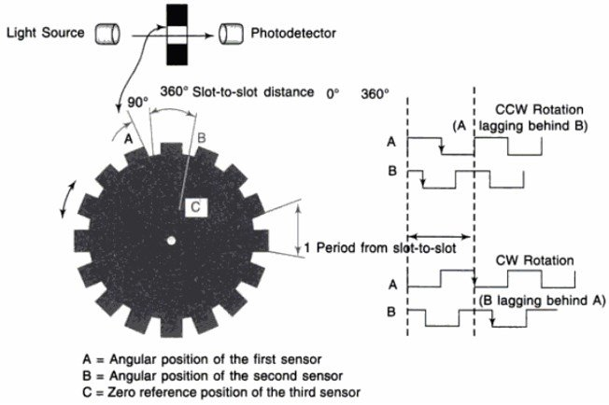
Parallel Device Ports
Rotary Encoder:-
A device, which measures the angular or linear position of a rotating or moving shaft.
Applications in robots and industrial plants.

Slide 92
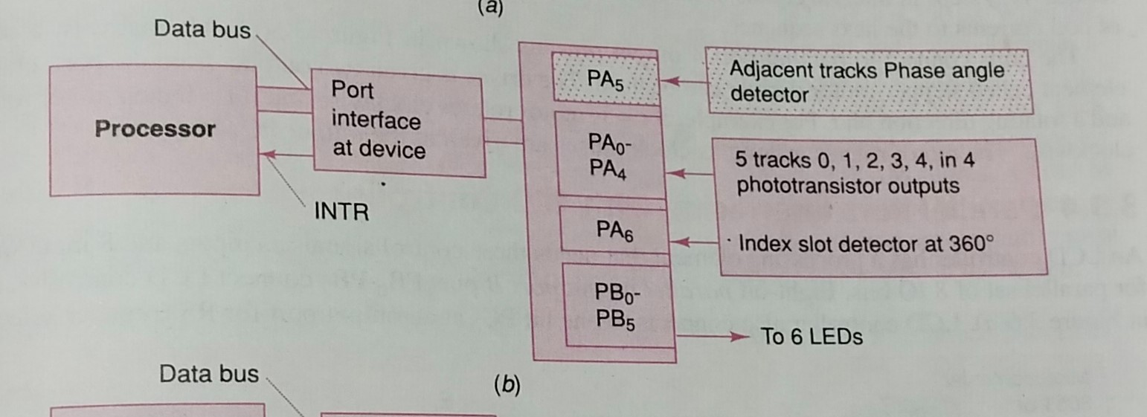
Parallel Device Ports
Multiple tracks on a rotating disk.
A linear encoder has multi-slotted plate. A set of n infrared (IR) LED and phototransistor pairs generate n-bit inputs for a port.

Slide 93
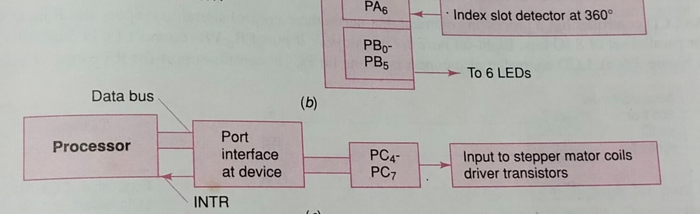
Parallel Device Ports
Parallel port interfacing with stepper motor

Slide 94
Parallel Device Ports
Four outputs may be used as driver to four coils of a stepper motor.
Sequences at the intervals of T are changed as follows: 1000,0100,0010,0001,1000,0100,…… [The bits in the nibble (set of 4 bits) rotate by right shift.]
Sequences are changed to rotate the motor in reverse direction 0001, 00010, 0100 ,1000,0001,0010,….[The bits in the nibble(set of 4 bits) rotate by left shift.]

Slide 95
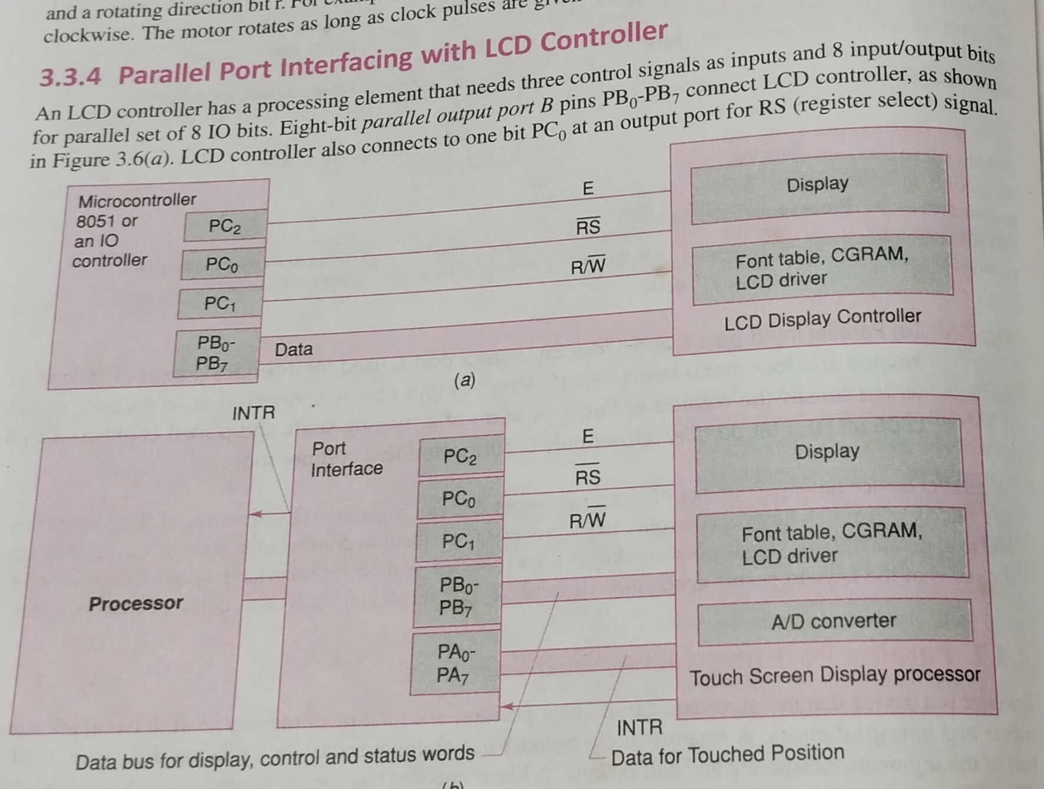
Parallel Device Ports
Parallel port interfacing with LCD Controller

Slide 96
Parallel Device Ports
Three control signals IO PC0-PC2 as inputs to LCD controller.
PB0 to PB7 8 input/output bits for parallel set of 8 IO bits for commands and data.
LCD controller is sent control words and data words for initialization and programming by setting the PB0-PB7, PC0 and PC1 outputs for each word to LCD controller.

Slide 97
Wireless Devices
Wireless devices use infrared (IR) or radio frequencies after suitable modulation of data bits.
Popular protocols - IrDA, Bluetooth, 802.11 and Zigbee

Slide 98
Radio frequencies communication over long distances
Transmitter and receiver antennae to transmit and receive the signals.
Modulator and demodulators to carry the data bits using RF frequencies.
Mobile GSM wireless devices use 890 Mhz-915 Mhz or 1710 -1785 Mhz or 1859-1910 Mhz bands.
Mobile CDMA wireless devices use 2 Ghz carrier frequencies.

Slide 99
Radio frequencies communication over short distances
Bluetooth 2.4 Ghz
Zigbee wireless devices 900 Mhz frequencies.

Slide 100
Frequency Band Limitation
Space division Multiplexing
Time division multiplexing and frequency division multiplexing.
Innovative method spread spectrum and CDMA.
Radio Frequency hoping over a wider spectrum.

Slide 101
Timer And Counting Devices
Timer:-
Timer is a device, which counts the input at regular interval (δT) using clock pulses at its input.
The counts increment on each pulse and store in a register, called count register.
The counts multiplied by the interval δT give the time.
The (present counts-initial counts) x δT at regular interval gives the time interval between two instances when present count bits are read and initial counts were read or set.
Has an input pin(or a control bit in control register) for resetting it for all count bits=0s.
Has an output pin(or a status bit in status register) for output when all count bits=0s after reading the maximum value, which means after timeout or overflow.

Slide 102
Timer And Counting Devices
Counter:-
A device, which counts the input due to the events at regular or irregular intervals.
The counts gives the number of input events or pulses since it was last read.
Has a register to enable read of present counts.
Functions as timer when counting regular interval clock pulses.

Slide 103
Blind Counting Synchronization
It is also known as free running counter.
A counting device may be a free running (blind counting) device giving overflow interrupts at fixed intervals.
A pre-scalar for the clock input pulses to fix the intervals.
A register for capturing the counts on an instance for an input (0 to 1 or 1 to 0 or toggling) transition.
A status bit can also sets in and processor interrupt can occur for the capture event.
It has an output pin (or a status bit in status register) for output when all count bits = 0s after reaching the maximum value, which means after timeout or overflow.
Free running n-bit counter overflows after p x 2n x δT interval.

Slide 104
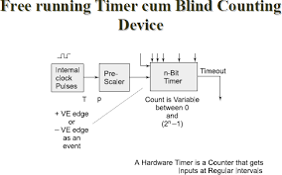
Blind Counting Synchronization

Slide 105
Timer cum Counting Device
A timer cum counting device is a counting device that has two functions.
(1) It counts the input due to the events at irregular instances.
(2) It counts the clock input pulses at regular intervals.

Slide 106

Uses of a Timer

Slide 107

Uses of a Timer

Slide 108

States in a Timer

Slide 109

Timer cum Counting device

Slide 110
Software timer:-
A software, which executes and increases or decreases a count variable(count value) on an interrupt from on a system timer output or from on a real time clock interrupt.
The software timer also generate interrupt on overflow of count-value or on finishing value of the count variable.
In a system an hardware-timing device is programmed to tick at constant intervals.
At each tick there is an interrupt.
A chain of interrupts thus occur at periodic intervals.

Slide 111
Software timer:-
The interval is as per a preset count value.
The interrupts are called system clock interrupts, when used to control the schedules and timings of the system.

Slide 112


Slide 113
Software timer:-
SWT is a timer based on the system clock interrupts.
The interrupt functions as a clock input to an SWT.
This input is common to all the SWTs that are in the list of activated SWTs.
Any number of SWTs can be made active in a list.
Each SWT will set a status flag on its timeout (count-value reaching 0)
Actions are analogous to that of a hardware timer. While there is physical limit (1,2 or 3 or 4) for the number of hardware timers in a system, SWTs can be limited by the number of interrupt vectors provided by the user.
Certain processors also defines the interrupt vector addresses of 2 or 4SWTs

Slide 114
Watchdog timer
A timing device such that it is set for a preset time interval and an event must occur during that interval else the device will generate the timeout signal on failure to get that event in the watched time interval.
On that event, the watchdog timer is disabled to disable generation of timeout or reset
Timeout may result in processor start a service routine or start from beginning.

Slide 115
Assume that we anticipate that a set of tasks must finish in 100 ms interval.
The watchdog timer is disabled and stopped by the program instruction in case of the tasks finish within 100ms interval
In case task does not finish, watchdog timer generates interrupts after 100ms and executes a routine, which is programmed to run because there is failure of finishing the task in anticipated interval.

Slide 116
Watchdog timer application
An application in mobile phone is that display is off in case no GUI interaction takes place within a watched time interval.
The interval is usually set at 15 s, 20 s, in mobile phone.
This saves power

Slide 117
Real time clock
A clock, which is based on the interrupts at preset intervals. An interrupt service routine executes on each timeout (overflow) of this clock.
This timing device once started never resets or never reloaded with another value. Once it is set, it is not modified later.
Used in a system to save the time and date.
Used in a system to initiate return of control to the system (OS) after the set system clock periods.

